Slide 1
Red Hat OpenShift DO285
2021.05

Slide 2
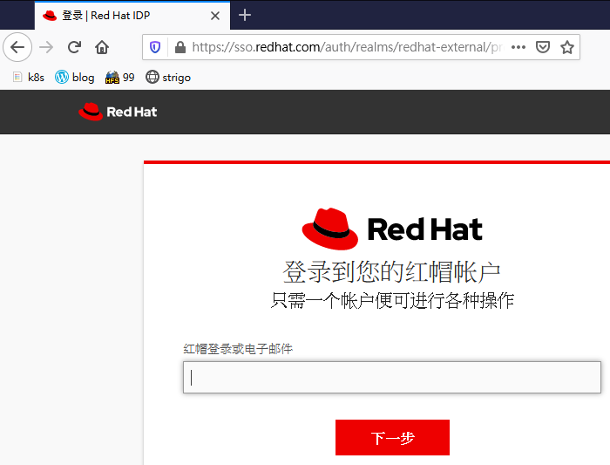
Red Hat LAB
https://rol.redhat.com
以 email 或 帳號登入
LoginID不可以有空白
忘記密碼
要能收 email
如果都不work，請更換新密碼，強制清除token

Slide 3
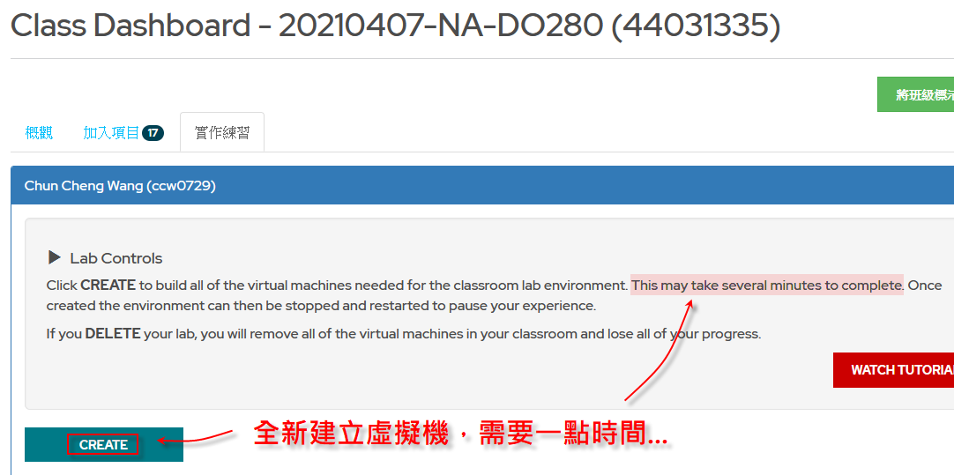
Create LAB

Slide 4
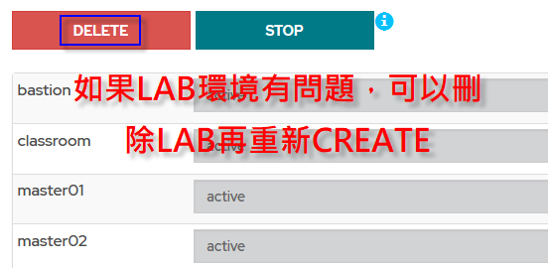
Delete LAB

Slide 5
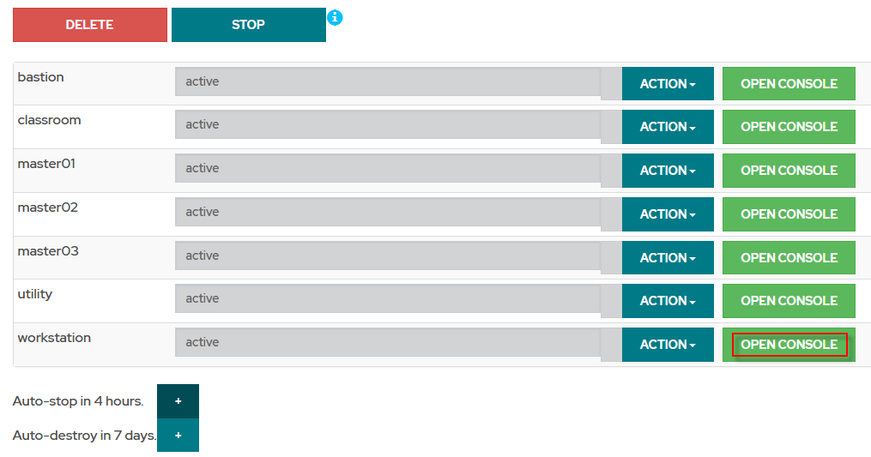

Slide 6
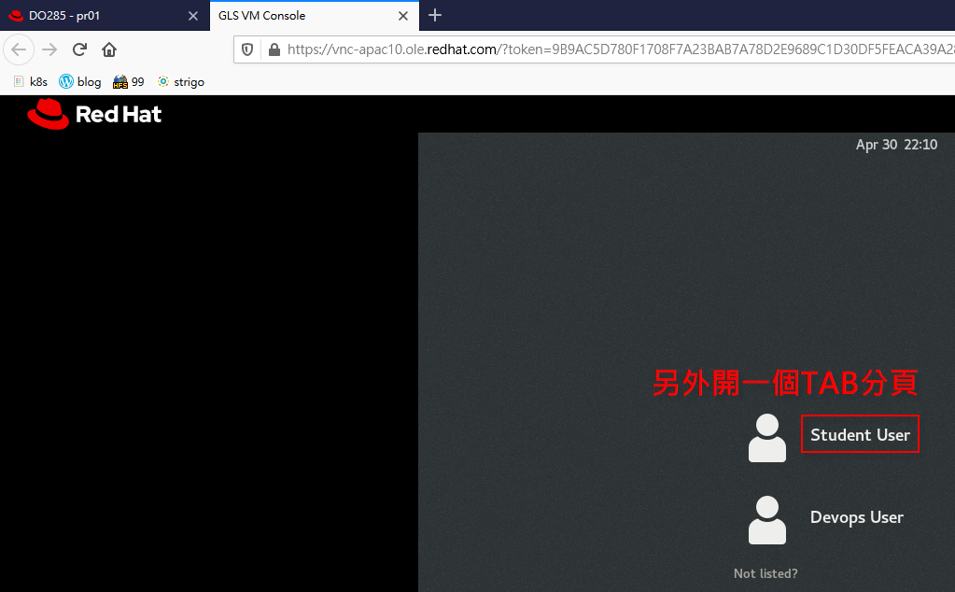

Slide 7
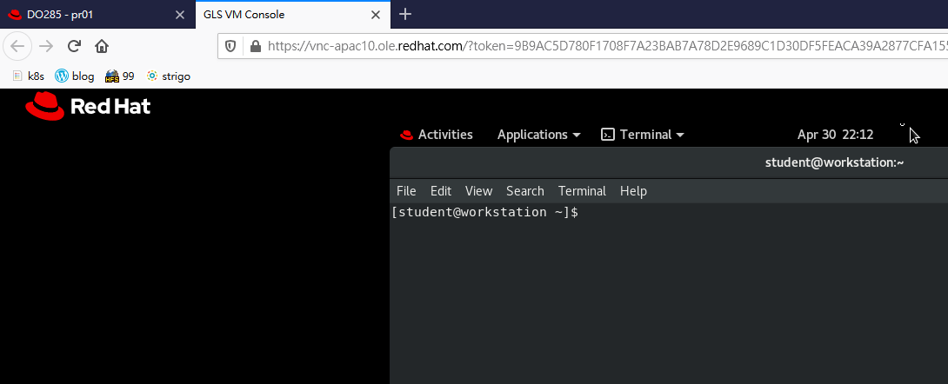

Slide 8
DO180 → EX180
DO280 → EX280
DO285 → EX180, EX280
DO380

Slide 9
Docker
Docker/container
container

Slide 10
kubectl get nodes
oc get nodes
docker pull mysql
podman pull mysql

Slide 11
yum install xxx
yum install /bin/oc
yum install /sbin/oc
yum install /usr/bin/oc
yum install /usr/sbin/oc

Slide 12
OS
root/redhat
student/student OR password
OpenShift
admin/redhat
developer/developer

Slide 13
management network【ex:eth0】
docker network
service network【172.30.0.0/16】DMZ
pod network【10.128.0.0/14，10.128.0.1 – 10.131.255.254】

Slide 14
VLAN【0-4095】
VXLAN【5000-2²⁴】

Slide 15
etcd

Slide 16
Red Hat CoreOS

Slide 17
lab-configure
/usr/local/etc/ocp4.config
/usr/local/etc/ocp4.default
# find / -name ocp4
source /usr/local/etc/ocp4.config

Slide 18
docker | podman
yum install docker –y | yum install podman –y
systemctl start docker systemctl enable docker | No services
/var/lib/docker | /var/lib/containers/storage/overlay-images

Slide 19
K8s namespace ← → OpenShift project

Slide 20
Recreate
Rolling Update
Blue/Green
Canary

Slide 21
Registry
Harbor

Slide 22
CI/CD
Jenkins
S2I

Slide 23
LVM
pvcreate
vgextend
lvextend

Slide 24
podman inspect xxx | grep -i ipaddr

Slide 25
sudo podman run --name mysql-2 -e MYSQL_ROOT_PASSWORD=12345678 -d rhmap47/mysql

Slide 26
example.com
svc.example.com
<namespace>.svc.example.com
<servicename>.<namespace>.svc.example.com

Slide 27
podman stop <ID>
podman rm <ID>
podman rmi <containID>

Slide 28
sealert -a /var/log/audit/audit.log

Slide 29
https://andersonwang.wordpress.com/2021/03/22/docker-hub-rate-limitint-關於-docker-官網的下載限制/

Slide 30
https://catalog.redhat.com/software/containers/explore

Slide 31
https://andersonwang.wordpress.com/2018/01/12/python-網頁爬蟲與-docker-整合/

Slide 32
fence network

Slide 33
netfilter
iptables

Slide 34
podman rmi -a --force

Slide 35
2.1
-. 3.0
-. 2.2
-. 2.1.1
-. 2.1-1

Slide 36
/tmp/333/Dockerfile
FROM …
RUN yum install httpd –y
…
…
COPY rhel_dvd.repo /etc/yum.repod.s/rhel_dvd.repo
Container Host /tmp/333/rhel_dvd.repo → New Container Image /etc/yum.repos.d/rhel_dvd.repo

Slide 37
GRUB
LILO
lilo -v -v -v

Slide 38
project
-. route
--. service
---. deployment
----. pod

Slide 39
K8s
<servicename>.<namespace>.<subdomain>.example.com
OpenShift route
<routename>-<projectname>.<subdomain>.example.com
*.example.com
*.*.example.com
*.app.example.com【wildcard certficate】

Slide 40
https://docs.docker.com/develop/develop-images/dockerfile_best-practices/

Slide 41
https://quay.io/user/ccw0729

Slide 42
oc get is【current project】
oc get is -n openshift【指定project】
oc policy
oc adm policy …
oc adm policy … -n <projectA>

Slide 43
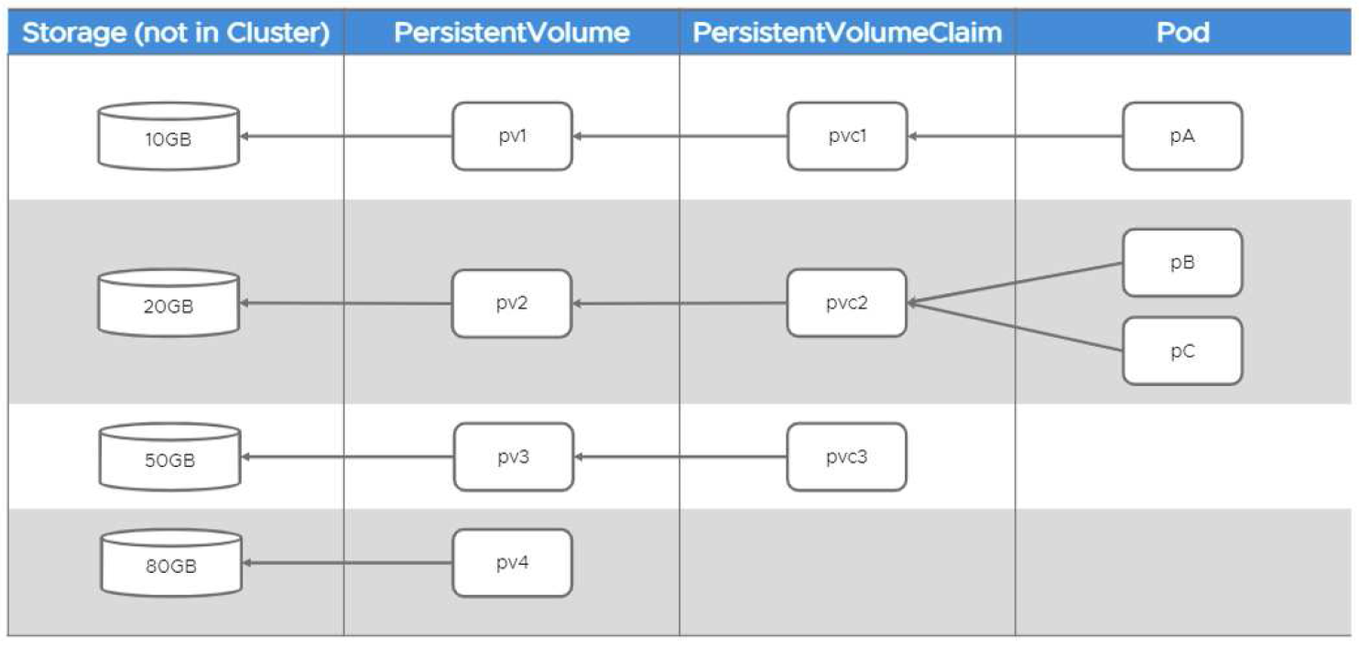

Slide 44
Static → 預先部屬
Dynamic → On-daemon

Slide 45
Access mode
-. RWO【Read Write Once】ex: Jenkins
-. RWX【Read Write Many】
-. ROX【Read Only Many】

Slide 46
CRI【Container Runtime Interface】

Slide 47
Master node → 2N + 1
Work node → 2,3,4…

Slide 48
OpenShift ← → RHEL
OKD ← → Fedora

Slide 49
configMAP → 明碼
secret → base64 encode/base64 decode

Slide 50
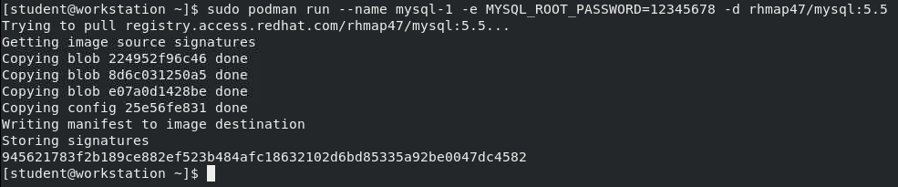
podman傳參數 -e
sudo podman run --name mysql-1 -e MYSQL_ROOT_PASSWORD=12345678 -d rhmap47/mysql:5.5

Slide 51
dockerfile設定env
FROM rhmap47/mysql:5.5
ENV MYSQL_ROOT_PASSWORD="12345678"
sudo podman build -t mysql-2 .

Slide 52
OpenShift 指令+參數
oc new-app --docker-image= \
registry.access.redhat.com/rhscl/mysql-57-rhel7:latest \
--name=mysql-openshift-2 \
-e MYSQL_ROOT_PASSWORD=12345678
oc describe pod mysql-openshift-2-xxx | grep MYSQL_ROOT_PASSWORD

Slide 53
使用yaml檔指定參數
apiVersion: v1
kind: Pod
metadata:
name: pod1-mysql # oc get pods 會查到的 pod 名稱
spec:
containers:
- name: pod1-mysql
image: registry.access.redhat.com/rhscl/mysql-57-rhel7:latest
env:
- name: MYSQL_ROOT_PASSWORD
value: 12345678

Slide 54
secrets傳參數
echo '12345678' | base64
oc create secret generic mysql-password-1 \
--from-literal MYSQL_ROOT_PASSWORD=MTIzNDU2NzgK

Slide 55
從secret匯出到檔案
oc extract secret/mysql-password-1 --to /tmp/ --confirm
ls -l /tmp/mysql-password-1
cat /tmp/mysql-password-1

Slide 56
yaml與secret整合
apiVersion: v1
kind: Pod
metadata:
name: pod2-mysql # oc get pods 會查到的 pod 名稱
spec:
containers:
- name: pod2-mysql
image: registry.access.redhat.com/rhscl/mysql-57-rhel7:latest
env:
- name: MYSQL_ROOT_PASSWORD
valueFrom:
secretKeyRef:
name: mysql-password-1
key: MYSQL_ROOT_PASSWORD

Slide 57
Regular user：相當於UID 1000-60000
System user：相當於UID 0
Service accounts：相當於UID 1-999

Slide 58
container images預設值
podman … -e …
oc … -e …
configMAP
secret
persistent storage

Slide 59
cmd1 && cmd2
cmd1 || cmd2

Slide 60
oc create -f xxx.yaml
oc apply -f xxx.yaml
kubectl apply -f xxx.yaml

Slide 61
CPU core * 1 = 1000 units = 1000m
4 core * 1000m = 4000m

Slide 62
oc whoami --show-console

Slide 63
Alpha
Beta
正式版

